Slide 1
Isolation of DNA
DNA
PCR DNA
Plasmid
Cosmid
Lambda

Slide 2
Bacteria and Humans
Pathogens – disease causing agents (Pathology – science of studying diseases)
Can produce poisonous toxins (poisons)
Endotoxins are made of lipids & carbohydrates by Gram - bacteria & released after the bacteria die (cause high fever, circulatory vessel damage…) E. coli
Exotoxins are made of protein by Gram + bacteria . Secreted into environment. Clostridium tetani

Slide 3
Virus & Bacteria
Characteristic of life | Virus | Bacteria
Growth | No | Yes
Homeostasis | No | Yes
Metabolism | No | Yes
Mutation | Yes | Yes
Nucleic acid | DNA or RNA | DNA (and RNA)
Reproduction | Only within a host cell | Independently by cell division
Structure | Nucleic acid w capsid | prokaryotic cell

Slide 4
Diseases Caused by Bacteria
Anthrax
Botulism
Cholera
Cavities
Gonorrhea
Syphilis
Tetanus
Staph Infection (MRSA)
Food Poisoning
Lyme Disease
Diphtheria
Tuberculosis
Escherichia coli O157: H7
Leprosy
Meningitis
Strep throat
Whooping cough (Pertussis)

Slide 5
Diseases Caused by Viruses
AIDS
The Cold
Measles
Mumps
Rubella
Chicken pox/Shingles
Small Pox
Hepatitis
SARS
The Flu
Ebola
HPV
Bird Flu
Polio

Slide 6
Viruses are classified by their shape and structure
If it contains DNA:
  May produce RNA to make more viral proteins in host cell
  Join with host’s DNA to direct the production of virions (viral particles)
If it contains RNA:
  Retroviruses – such as HIV. Viral RNA uses host’s ribosomes for viral protein synthesis
  Reverse transcriptase – viral enzyme that uses RNA as template to make DNA. Then DNA integrates into host DNA and then when triggered, normal transcription occurs with the production of RNA and translation to produce new viruses. RNA to DNA to RNA to protein. Normal is DNA to RNA to protein.

Slide 7
Viroids – another disease causing agent but no capsid, only the RNA. Found only in plants
Prion – viral proteins that are able to cause diseases by clumping together within cell. 250 amino acids but no nucleic acid. Scrapie in sheep degrades nervous system. Mad Cow disease (Bovine spongiform encephalopathy) in cows – puts holes into brain. In humans, its Creutzfeld-Jakob disease.

Slide 8
Type of DNA
DNA
PCR DNA
Plasmid
Cosmid
Lambda

Slide 9
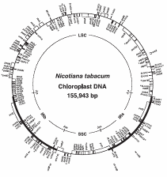
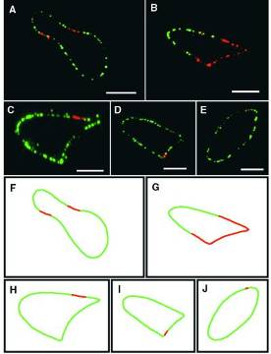
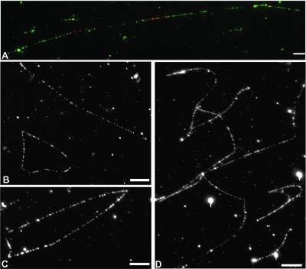
Circular Chloroplast DNAs
Tobacco ctDNA, EMBO J. 1986
Chlamy ctDNA, Plant Cell 2002
Chlamy
reinhartii
203kb
2001

Slide 10
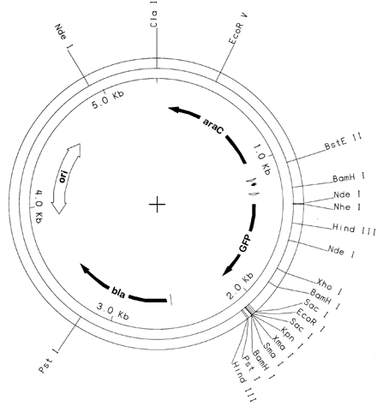
A more Detailed Look at Plasmids
Promotor Site
Origin of Replication
Antibiotic Resistance Gene
Multiple Cloning Site
Notes:
pGLO contains several genes that enable replication of the plasmid DNA and expression of the fluorescent trait (phenotype) in bacteria following transformation. Some of the essential genes include:
GFP — The jellyfish gene that codes for the production of Green Fluorescent Protein
bla — A gene that encodes the enzyme beta-lactamase, which breaks down the antibiotic ampicillin. Bacteria containing the bla gene can be selected by placing ampicillin in the growth medium
ori — The origin of pGLO plasmid DNA replication. Must be compatible with the origin of replication of host bacteria.
araC — A gene that encodes the regulatory protein that binds to the pBAD promoter. Only when arabinose binds to the araC protein is the production of GFP switched ON
pBAD Promoter — A specific DNA sequence upstream from the GFP gene, which binds araC-arabinose and promotes RNA polymerase binding and transcription of the GFP gene
Multiple Cloning Sites — Regions of known restriction (NdeI, HindIII, EcoRI, etc.) sites that permit insertion or deletion of the gene of interest

Slide 11
Features of Many Modern Plasmids
Small size
Origin of replication
Multiple cloning site (MCS)
Selectable marker genes
Some are expression vectors and have sequences that allow RNA polymerase to transcribe genes
DNA sequencing primers

Slide 12
The Major Limitation of Cloning in Plasmids
Upper limit for clone DNA size is 12 kb
Requires the preparation of “competent” host cells
Inefficient for generating genomic libraries as overlapping regions needed to place in proper sequence
Preference for smaller clones to be transformed
If it is an expression vector there are often limitations regarding eukaryotic protein expression

Slide 13
Lambda
Larger insert size
Introducing phage DNA into E.coli by phage infection is much more efficient than transforming E.coli with plasmid DNA
Have to work with plaques

Slide 14
Cosmids
Hybrid vectors: plasmids that contain bacteriophage lambda cos sites
DNA (~ 33-48 kb) cloned into restriction site, the cosmid packaged into viral particles and these phages used to infect E.coli
Cosmid can replicate in bacterial cell, so infected cells grow into normal colonies
Insert DNA limited by the amount of DNA that can fit into phage capsule
Somewhat unstable, difficult to maintain
ori
21.5 kb
Tet^{R}
cos
EcoRI
Cos site is the only requirement for packaging into phage particle

Slide 15
Other Vectors
BACs (Bacterial artificial chromosomes)
  Large low copy number plasmids (have ori and selectable marker)
  Can be electroporated into E. coli
  Useful for sequencing genomes, because insert size 100 - 300kb
YAC (Yeast Artificial Chromosome)
  Can be grown in E.coli and Yeast
  Miniature chromosome (contains ori, selectable markers, two telomeres, and a centromere
  Can accept 200 kb -1000 kb; useful for sequencing
Ti plasmids; to introduce genes into plants
Expression vectors

Slide 16
Plasmid Isolation
What is a plasmid ?
How does its name come around ?
Why do we have to isolate or purify it ?

Slide 17
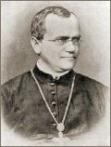
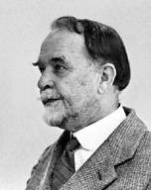

Plasmid Early History
Time-Line:
1903: Walter S. Sutton and Theodor Boveri independently hypothesize that the units of Mendelian characters are physically located on chromosomes.
Gregor Mendel
(1822-1884)
Thomas H. Morgan
1933, Nobel prize
for his study of
fruit flies
Paper in 1860
1910: Thomas Hunt Morgan (1866-1945) describes association of genes with a specific chromosome in the nucleus of Drosophila.
1920s-1940: Embryologists observe that there are hereditary determinants in the cytoplasm.
1950s: reported that cytoplasmic hereditary units in yeast mitochondria, and in the chloroplast of Chlamydomonas .

Slide 18
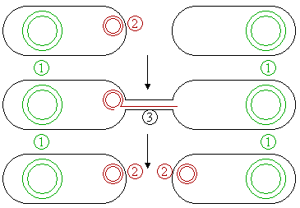
Plasmid Early History
1946 -1951: Joshua Lederberg et al., report strong evidence for a sexual phase in E. coli K-12. Meanwhile, lysogenic phages were also studied.
1950-1952: William Hayes suggests that mating in E. coli is an asymmetric (unidirectional) process.
1952: J. Lederberg reviews the literature on cell heredity and suggests the term "Plasmid" for all extrachromosomal hereditary determinants.
1952-1953: W. Hayes, and J. Lederberg, Cavalli, and E. Lederberg report that the ability to mate is controlled by a factor (F) that seems to be not associated with the chromosome.
Schematic drawing of bacterial conjugation.
1, Chromosomal DNA.
2, F-factor (Plasmids).
3, Pilus.

Slide 19
Plasmid Early History
1954: Pierre Fredéricq and colleagues show that colicine (plasmids) (large toxin proteins (50-70kD) ) behave as genetic factors independent of the chromosome.
1958: François Jacob and Elie Wollman propose the term "Episome" to describe genetic elements such as F factor, colicine, and phage lambda, which can exist both in association with the chromosome and independent of it.
1961: DNA (radioactive) labeling show that mating in bacteria is accompanied by transfer of DNA from the donor to the recipient.
1962: In a review on episomes, Allan Campbell proposes the reciprocal recombination of circular episome DNA molecules with the chromosomal DNA. 1962: Circular DNA is found to actually exist in the genome of the small phage phi-X174.

Slide 20
Plasmid Early History
with the help of CsCl gradient method
1963: Alfred Hershey shows that bacteriophage lambda can form circles in vitro by virtue of its "cohesive ends".
  Other circular DNAs - the E. coli genome and polyoma virus DNA are visualized as well.
1967: R. Radloff, William Bauer, and J. Vinograd describe the CsCl dye-bouyant density method to separate closed circular DNA from open circles and linear DNA, thus facilitating the physical study of plasmids.
1969: M. Bazarle and D. R. Helinski show that several colicine factors are homogeneous circular DNA molecules.
By the end of the 1960s, both the genetic and physical nature of plasmids and cytoplasmic heredity had been known in detail and the "Modern Period" of Plasmid Research starts - recombinant DNA technology.
1970s-80s: the Cytoplasmic mitochondrial and chloroplast DNAs in green algae and plants have been continuously studied and their circular forms of dsDNAs are not being visualized until very recently.

Slide 21
What is Plasmid?
Plasmid is autonomously replicating, extrachromosomal circular DNA molecules, distinct from the normal chromosomal DNAs and nonessential for cell survival under nonselective conditions.
Episome no longer in use.
They usually occur in bacteria, sometimes in eukaryotic organisms (e.g., the 2-um-ring in yeast S. cerevisiae).
Sizes: 1 to over 400 kb.
Copy numbers: 1 - hundreds in a single cell, or even thousands of copies.
Every plasmid contains at least one DNA sequence that serves as an origin of replication or ori (a starting point for DNA replication, independently from the chromosomal DNA).

Slide 22
Plasmid
Plasmid- small circular piece of DNA
Contains:
  Origin of replication
  Selectable marker, example: antibiotic resistance
  At least one restriction enzyme recognition site

Slide 23
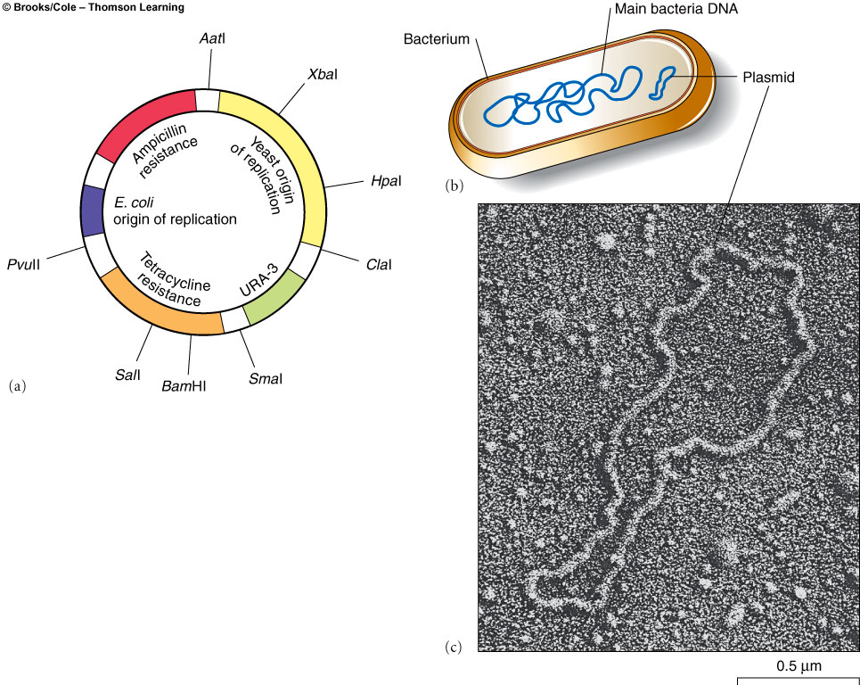
Plasmids

Slide 24
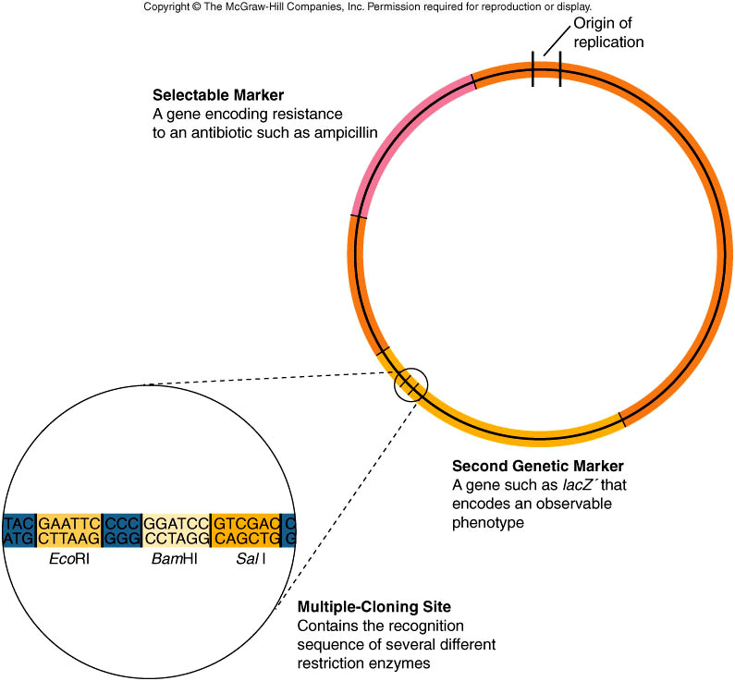

Slide 25
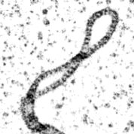
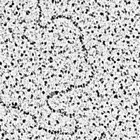
Plasmid DNAs
Plasmid DNA may appear in the following five conformations:
"Supercoiled" (or "Covalently Closed-Circular”) DNA is fully intact with both strands uncut.
2) "Relaxed Circular" DNA is fully intact, but "relaxed" (supercoils removed).
3) "Supercoiled Denatured" DNA. small quantities occur following excessive alkaline lysis; both strands are uncut but are not correctly paired, resulting in a compacted plasmid form.
4) "Nicked Open-Circular" DNA has one strand cut.
5) "Linearized" DNA has both strands cut at only one site.
Super Coiled
SC
Relaxed region
Nicked DNAs
Linear DNA

Slide 26
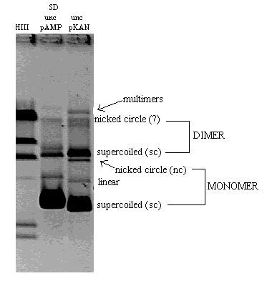
Conformation of Plasmid DNAs
The relative electrophoretic mobility (speed) of these DNA conformations in a gel is as follows:
Nicked Open Circular (slowest)
Linear
Relaxed Circular
Supercoiled Denatured
Supercoiled (fastest)

Slide 27
Types of Bacterial Plasmids
Based on their function, there are five main classes:
Fertility-(F)plasmids: they are capable of conjugation or mating.
Resistance-(R) plasmids: containing antibiotic or drug resistant gen(s). Also known as R-factors, before the nature of plasmids was understood.
Col-plasmids: contain genes that code for colicines, proteins that can kill other bacteria.
Degrative plasmids: enable digestion of unusual substances, e.g., toluene or salicylic acid.
Virulence plasmids: turn the bacterium into a pathogen.
Plasmids can belong to more than one of these functional groups.

Slide 28
R-plasmids often contain genes that confer a selective advantage to the bacterium hosts, e.g., the ability to make the bacterium antibiotic resistant.
Some common antibiotic genes in plasmids: amp^{r}, APH3’-II (kanamycin), tet^{R} (tetracycline),cat^{R} (Chloramphenicol), spec^{r} (spectinomycin or streptomycin), hyg^{r} (hygromycin).
Some antibiotics inhibit cell wall synthesis and others bind to ribosomes to inhibit protein synthesis

Slide 29
Development of Plasmid Vectors
Plasmids serve as important tools in genetics and biochemistry labs, where they are commonly used to multiply or express particular genes.
Plasmids used in genetic engineering are called vectors.
Vectors are vehicles to transfer genes from one organism to another and typically contain a genetic marker conferring a phenotype.
Most also contain a polylinker or multiple cloning site (MCS), with several commonly used restriction sites allowing easy insertion of DNA fragments at this location.
Many plasmid vectors are commercially available.
Old vector pBR322: 4.36kb, Ampicilin-R, Tetracylin-R, 15-20 copies/cell
Old vectors pUC18/19: 2.69kb, Ampicilin-R, LacZ operon, 500-700 copies
Stratagen pBS-KS: 3.0kb, Ampicilin-R, LacZ operon, 500-700 copies/cell
Promega pGEM-T: 3.0 kb, Ampicilin-R, LacZ operon, 500-700 copies/cell
Invitrogen TOPO-TA: 3.96kb, Ampicilin-R, Kan-R, LacZ, 500-700 copies
pCAMBIA vectors: >10kb, Amp-R/Kan-R/Hyg-R, LacZ, 1-3 copies
see more at http://seq.yeastgenome.org/vectordb/vector_pages/

Slide 30
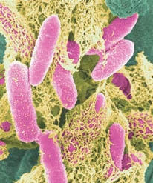
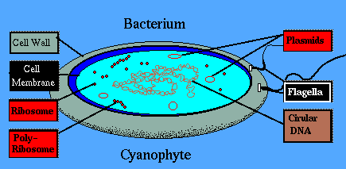
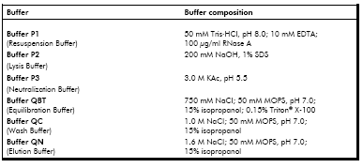
Plasmid Isolation from Bacteria
How to rapidly isolate plasmid?
Inoculation and harvesting the bacteria
Lysis of the bacteria (heat, detergents (SDS or Triton-114), alkaline(NaOH))
Neutralization of cell lysate and separation of cell debris (by centrifugation)
Or other cell types

Slide 31
DNA Extraction
Detergent: dissolves the plasma membrane
  Washing dishes with detergent
Heat block for 15 min helps the process
  Washing dishes with detergent in warm water
Add COLD alcohol
  Precipitates the DNA
  Look for DNA at the interphase

Slide 32
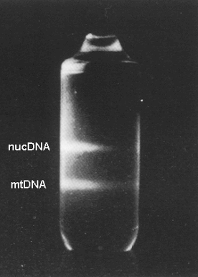
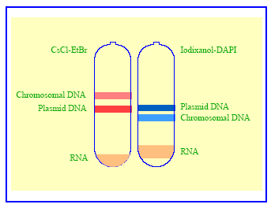
Isolation & Purification of DNA
Banding of plasmids and chromosomal DNAs in CsCl-EtBr and in iodixanol-DAPI gradients by CsCl Gradient centrifugation or
CsCl dye-bouyant density method
After 10 hrs centrifugation at 100,000 rpm (450,000 xg), two distinct bands, corresponding to linear nuclear DNA above and circular mitochondrial DNA below, are visible under ultraviolet light.

Slide 33
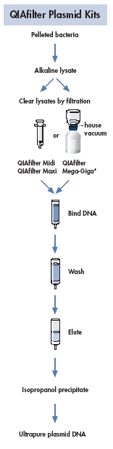
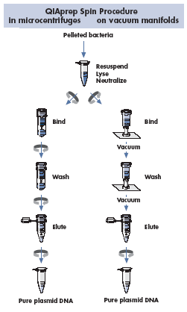
Plasmid DNA Isolation
Midi Prep
Mini Prep
Traditional Ways
collecting plasmid DNA by centrifugation (after ethanol precipi-tation or through filters - positively charged silicon beads),
check plasmid DNA yield and quality (using spectrophotometer and gel electrophoresis).
spectrophotometer and gel electrophoresis

